Slide 1
FSST
Fast Random Access String Compression​
Original authors:​
Peter Boncz CWI boncz@cwi.nl ​
Thomas Neumann TUM neumann@in.tum.de
Viktor Leis FSU Jena viktor.leis@uni-jena.de​
Presented By:​
Kyle Kim kyleyh.kim@mail.utoronto.ca​
Vijay Sambamurthy v.sambamurthy@mail.utoronto.ca​

Slide 2
Overview
String Compression
Why is it important?
Usage in Databases
Implementations
Naïve solutions
Existing SOTA solutions (ex: LZ4)
FSST
Table format
Table construction
Optimizations
Evaluation
Q&A

Slide 3
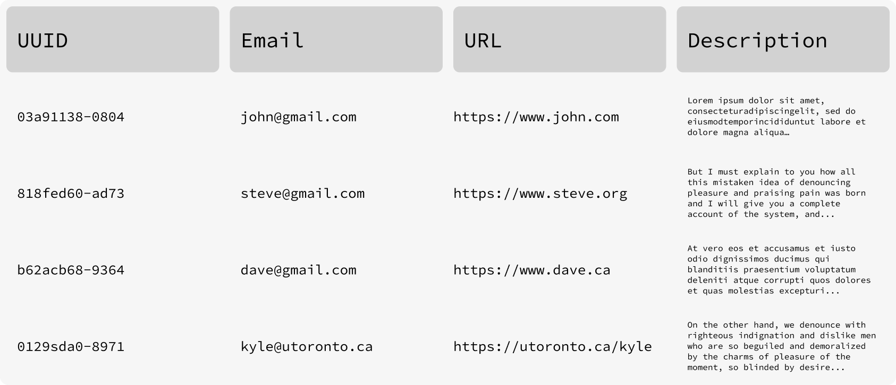

Motivation
A large fraction of data in databases is represented as strings.

Slide 4
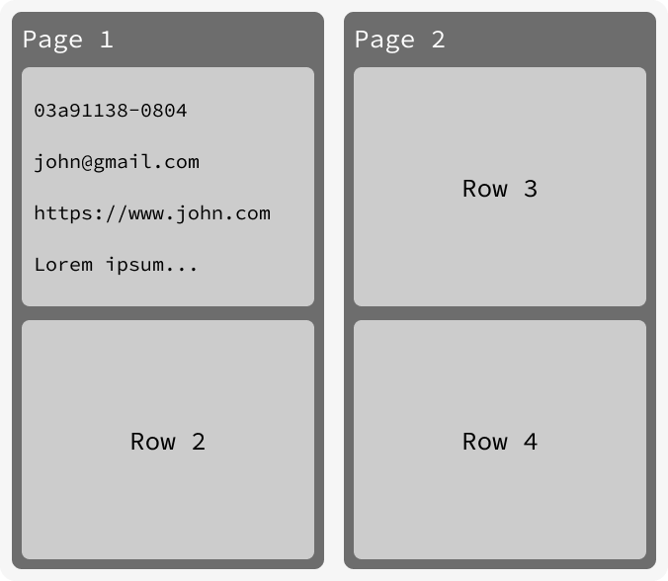
Motivation – How do we compress a DB?
Row-Store representation

Slide 5
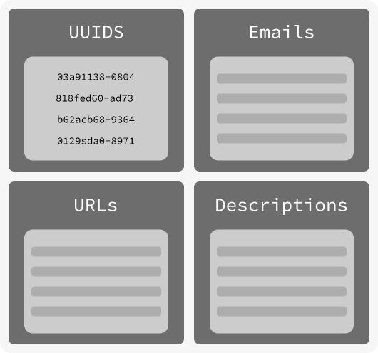
Motivation – How do we compress a DB?
Column-Store representation

Slide 6
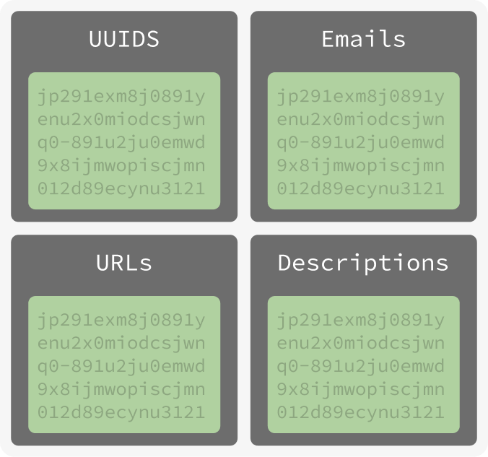
Motivation – How do we compress a DB?
Option 1: Compress database blocks
Compress files on disk as a whole

Slide 7
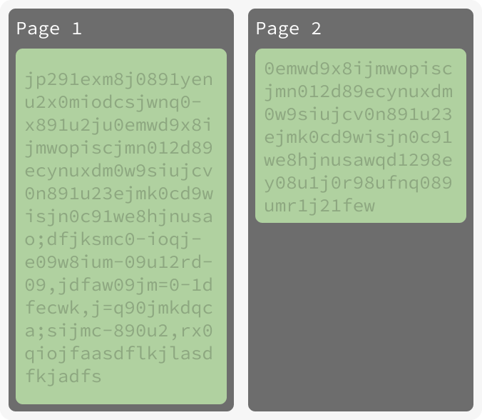
Motivation – How do we compress a DB?
Option 1: Compress database blocks
Compress files on disk as a whole

Slide 8
Motivation – How do we compress a DB?
Option 1: Compress database blocks
Problems?
How do we do random access?!

Slide 9
Motivation
Let us narrow and focus on column stores for simplicity.

Slide 10
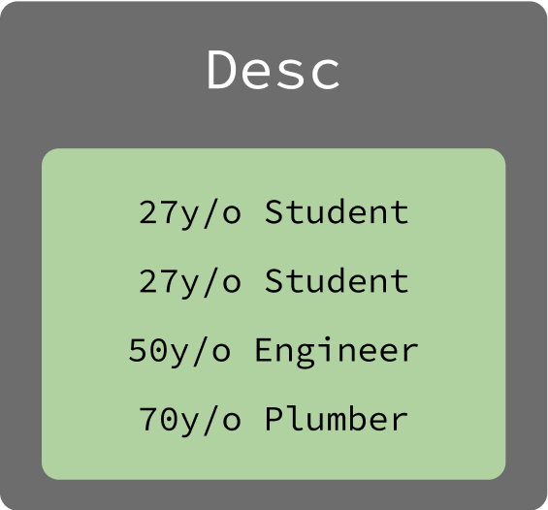
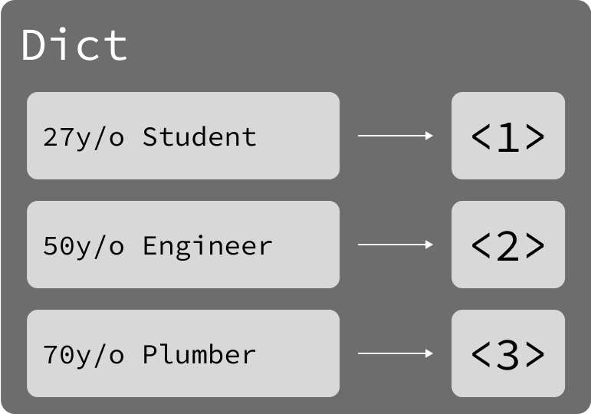
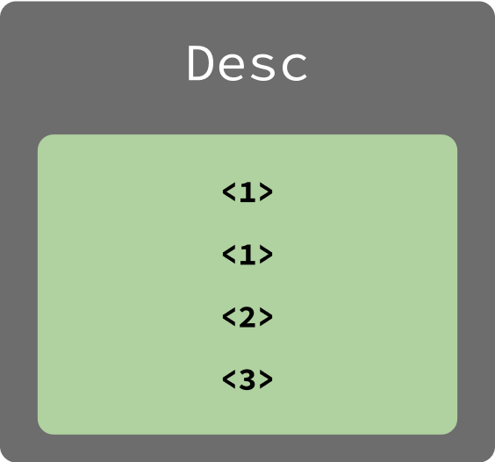
Motivation – How do we compress a DB?
Naïve Solution 2: Use dictionary to store repetitive strings
Map unique column entries to a unique dictionary entry.
Works well when a lot of repeated columns.
Works horribly when all columns are unique.

Slide 11



Motivation – What criteria do we need?
Speed
Compression & Decompression
Random Access
Required for most DB queries
Good Compression Ratio
Obviously :D

Slide 12
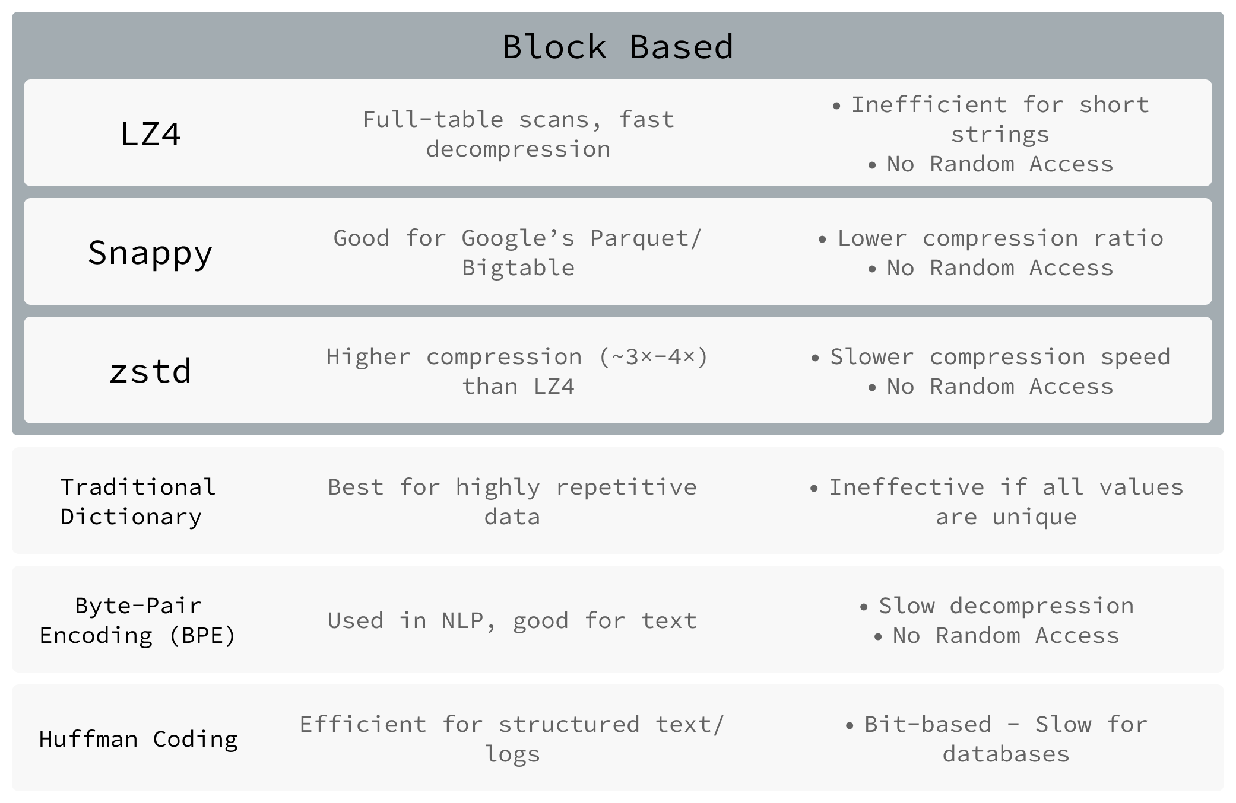
Existing Solutions

Slide 13
FSST

Slide 14
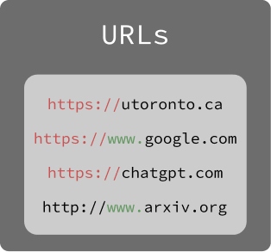
FSST – Observation
Type | Example
Email | vijay@gmail.com
UUIDs | fb61bf89-6bdc-4ebb-9c52-fac497368070
IP/MAC Address | 192.168.12.5
URLs | www.utoronto.ca
City/Town/Street | Toronto
Product SKU | ABC12345
Although individual strings are generally short...
Strings of the same column often have common substrings

Slide 15
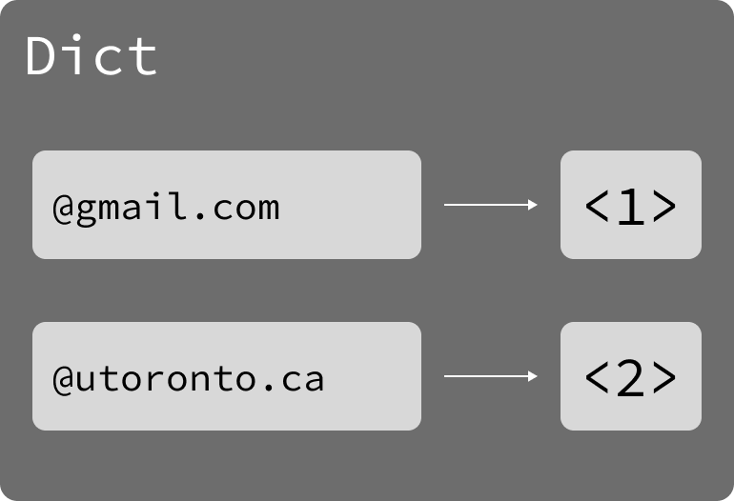
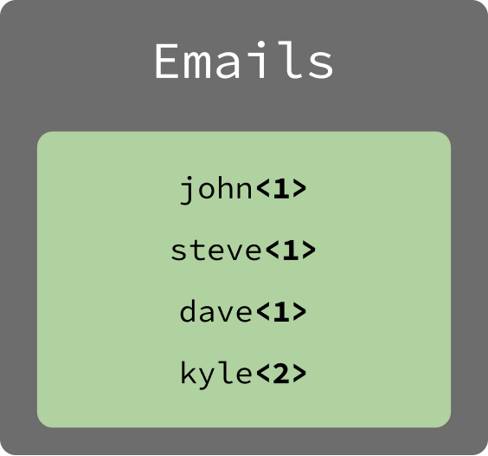
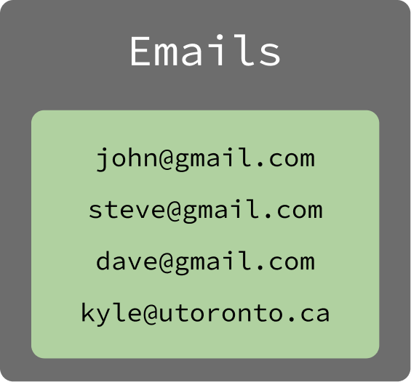
FSST – Abstract
Use dictionary on substrings
Find the most common substrings from the entire corpus (or sample set for efficiency), and store dictionary of them.
The symbol table “learns” from the corpus first, before the real encoding / decoding begins.

Slide 16
FSST – Symbol Table (Dict)
Use dictionary on substrings
256
\
0
Max symbol (dict) table size. Only 1 byte per symbol – fits in char
Reserve escape character for unique substrings.
Sometimes reserve entry for null termination of strings.
Practically, we have 255/254 symbols that we can use. Each symbol is at most 8 chars.

Slide 17
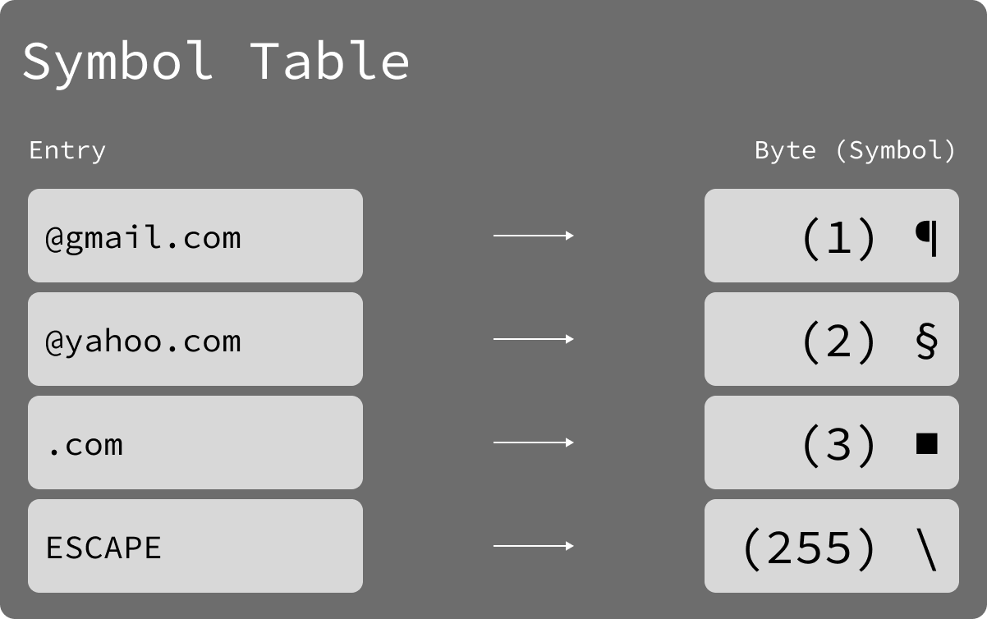


FSST – Example
Use dictionary on substrings
Length: 14
Length: 8

Slide 18


FSST – Example 2
Use dictionary on substrings
Length: 14
Length: 19
Notes:
Kyle: Going to mention that while this is possible, by the FSST table construction logic, this is very unlikely to happen.

Slide 19
Symbol Table
Clearly very important, how do we get a good symbol table?

Slide 20
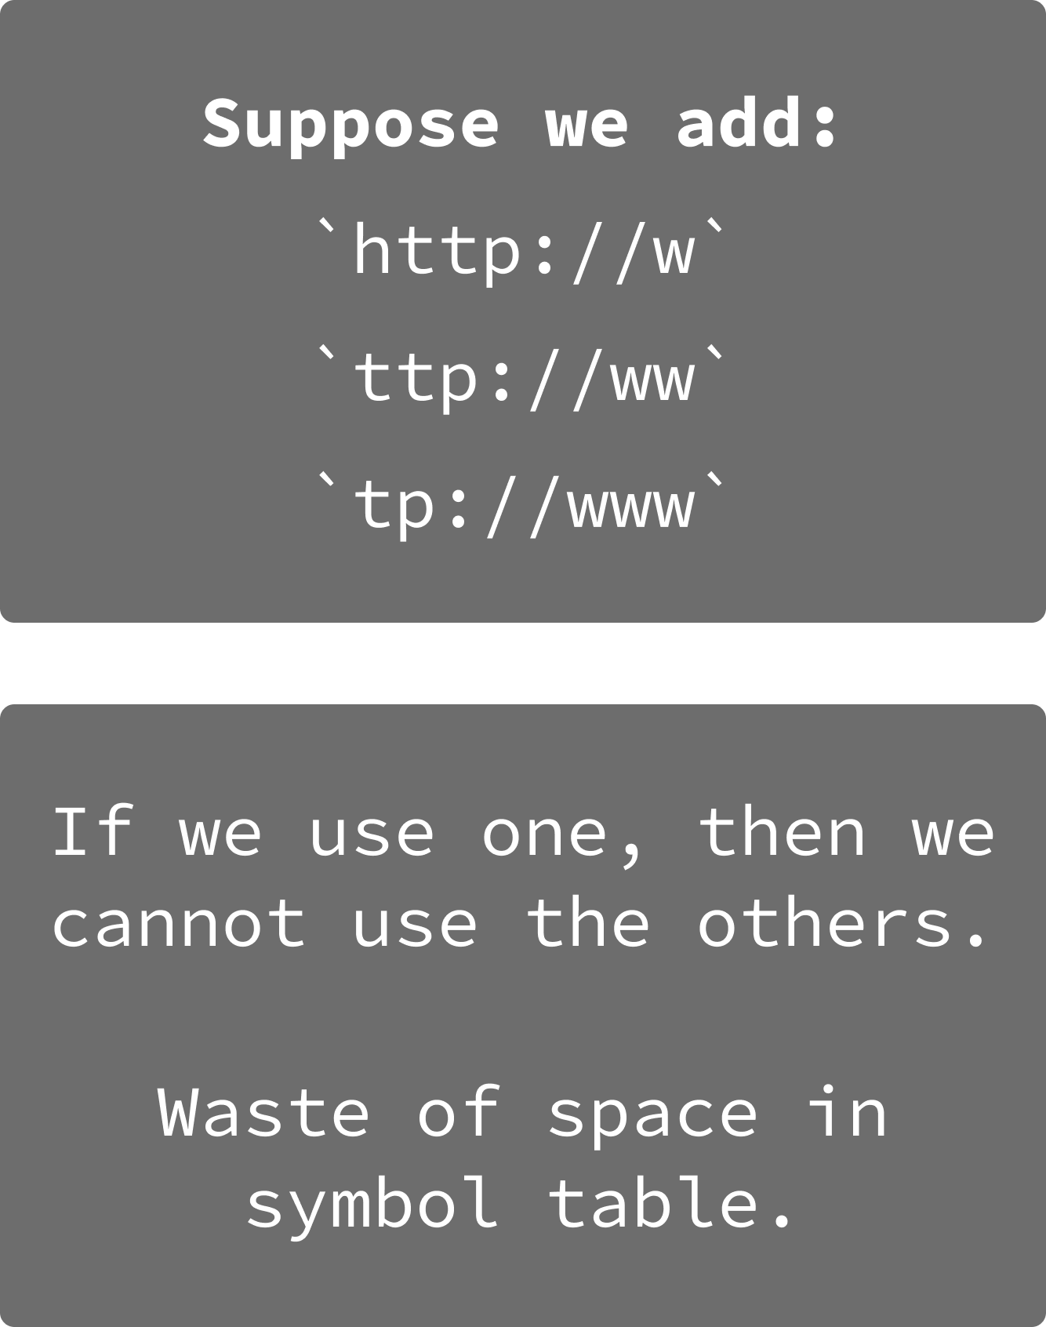
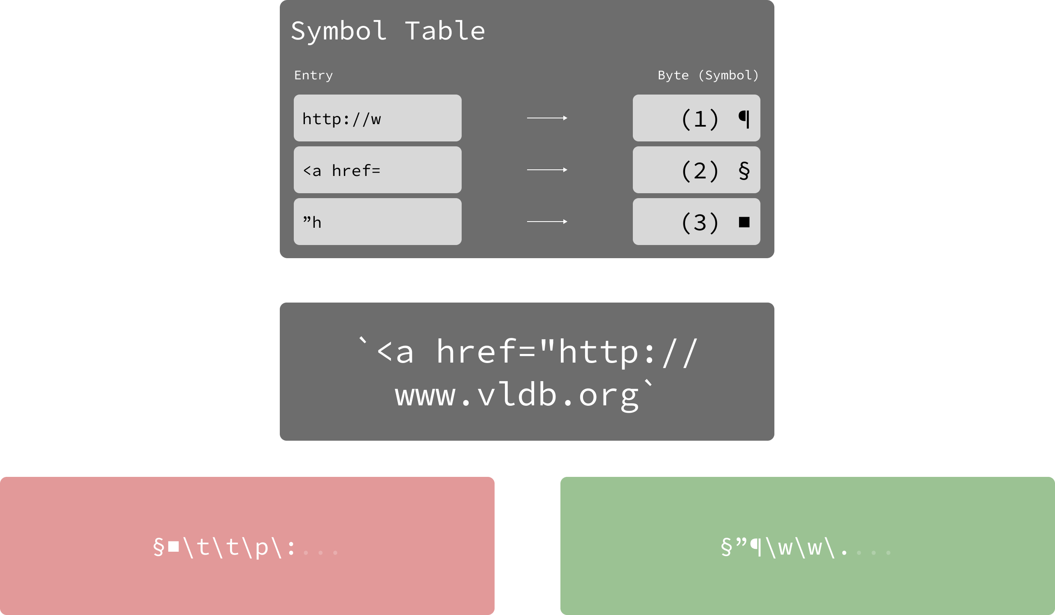
FSST – Symbol Table
Select Longest Substring (Greedy)
Consider URLS
Symbols may overlap
Not optimal for compression during encoding

Slide 21
Static Gain
Actual Gain
Computed based on frequency in the text
Actual measured compression/gain

Slide 22

FSST – Symbol Table
Generate all possible symbol tables
𝑂(N)
N * 8
$$\left({N∗8 \atop 255}\right)$$
To test a single solution. (Cost of compressing text)
Possible symbols. Since each symbol is at most 8 characters
Bound on the number of symbol tables.
Even if we consider top 3000 symbols (based on static gain, we get:
$\left({3000 \atop 255}\right)$
A number with 378 digits.
Notes:
For each character, you can have a substring starting there of lengths 1-8.

Slide 23

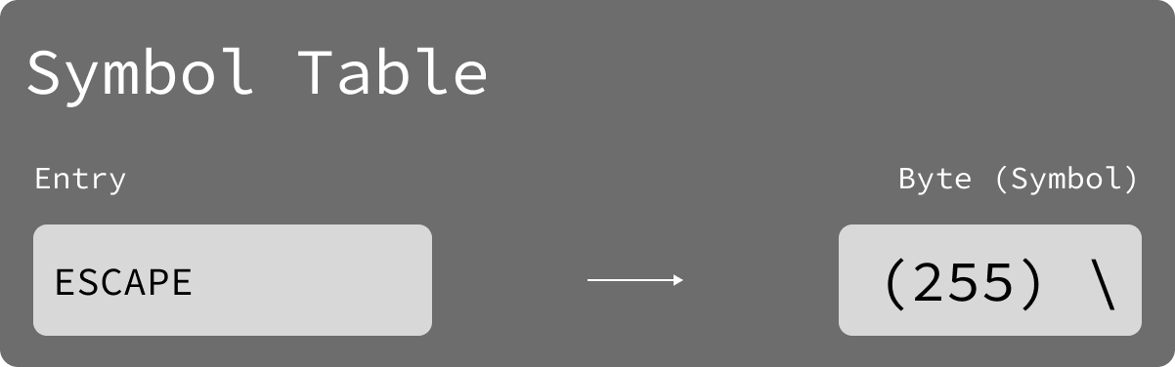
FSST – Symbol Table
Genetic-like bottom-up algorithm – MAX Symbol Size: 3, Symbol Table size: 5

Slide 24
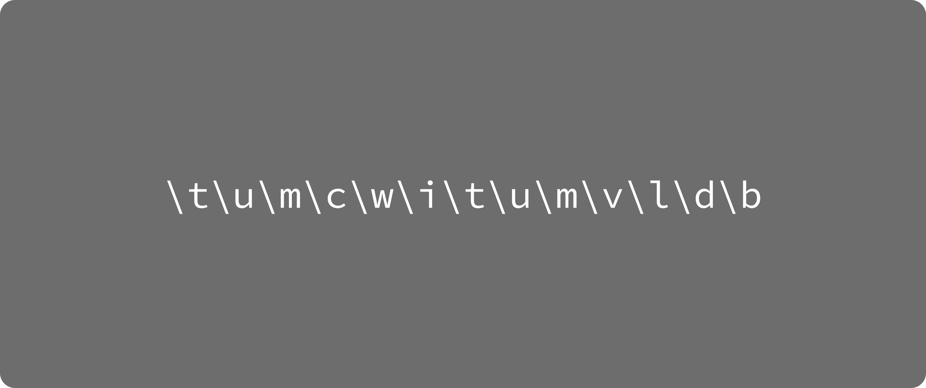
FSST – Symbol Table
Genetic-like bottom-up algorithm – MAX Symbol Size: 3, Symbol Table size: 5
t
u

Slide 25
FSST – Symbol Table
Genetic-like bottom-up algorithm – MAX Symbol Size: 3, Symbol Table size: 5
u
m

Slide 26
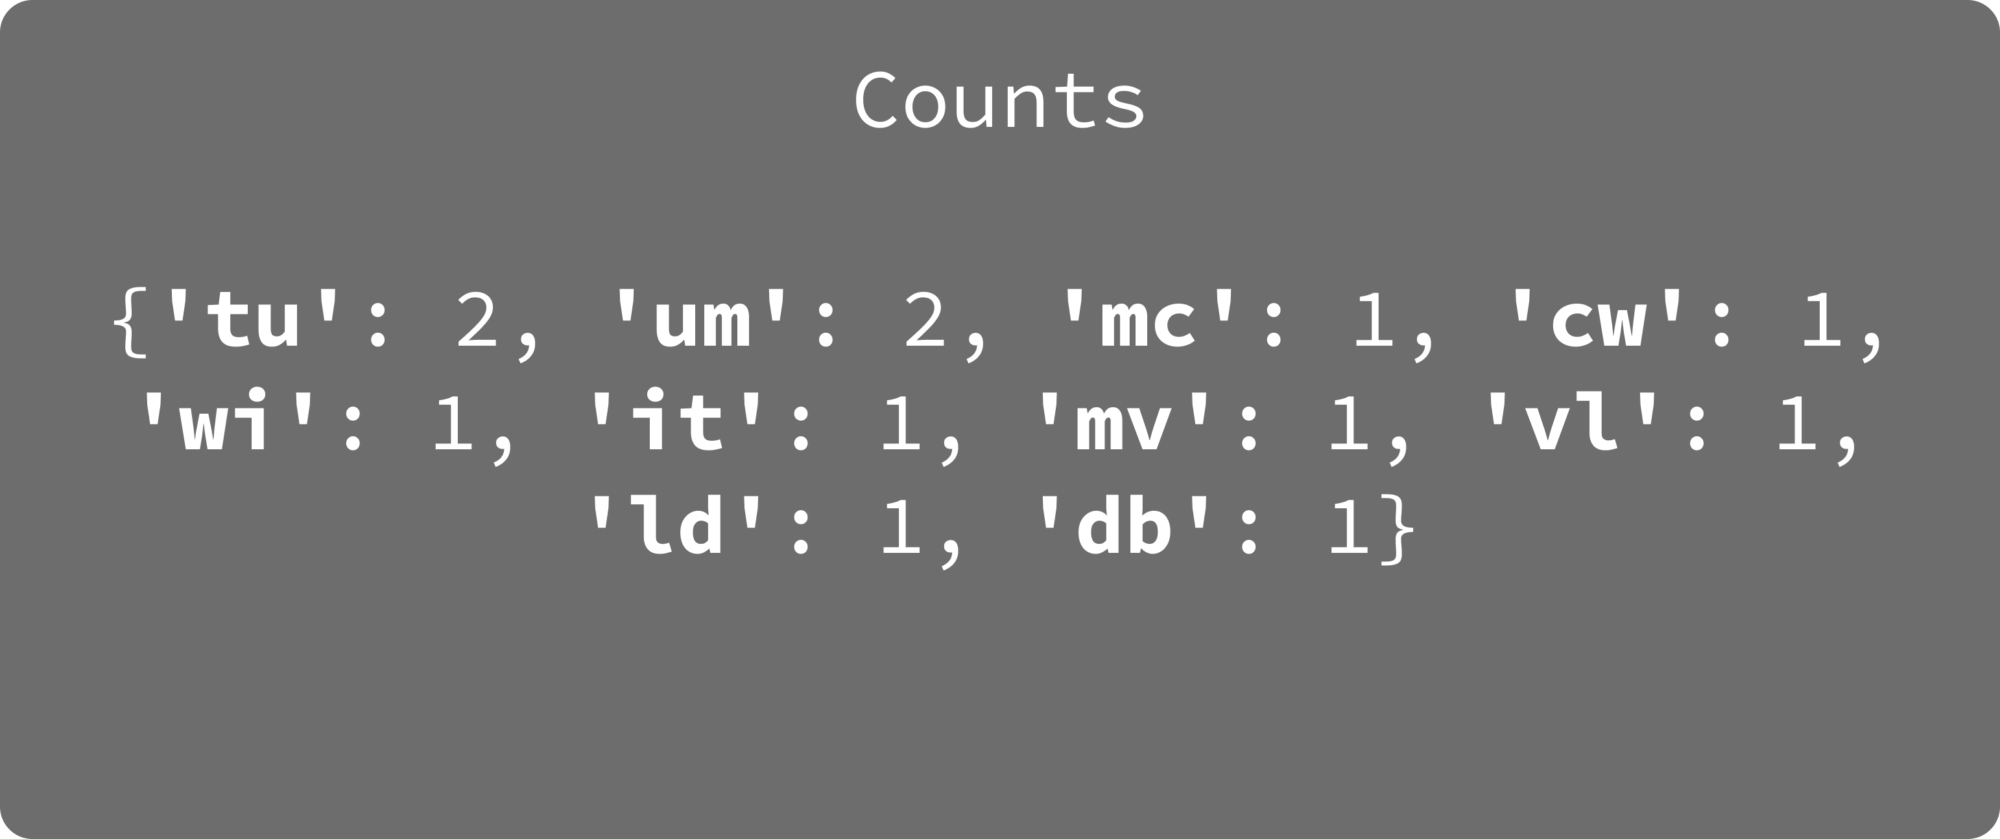
FSST – Symbol Table
Genetic-like bottom-up algorithm – MAX Symbol Size: 3, Symbol Table size: 5

Slide 27
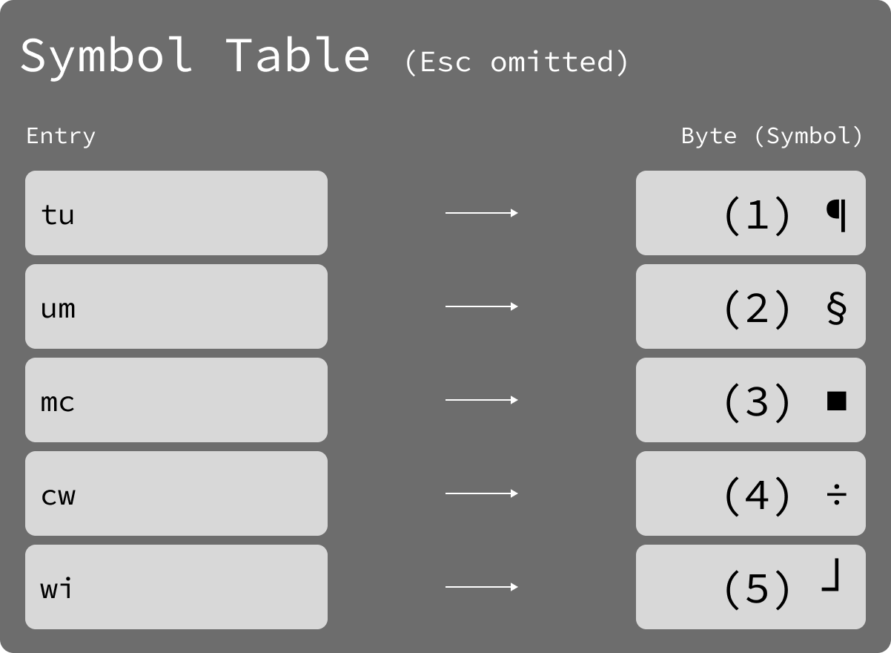
FSST – Symbol Table
Genetic-like bottom-up algorithm – MAX Symbol Size: 3, Symbol Table size: 5

Slide 28
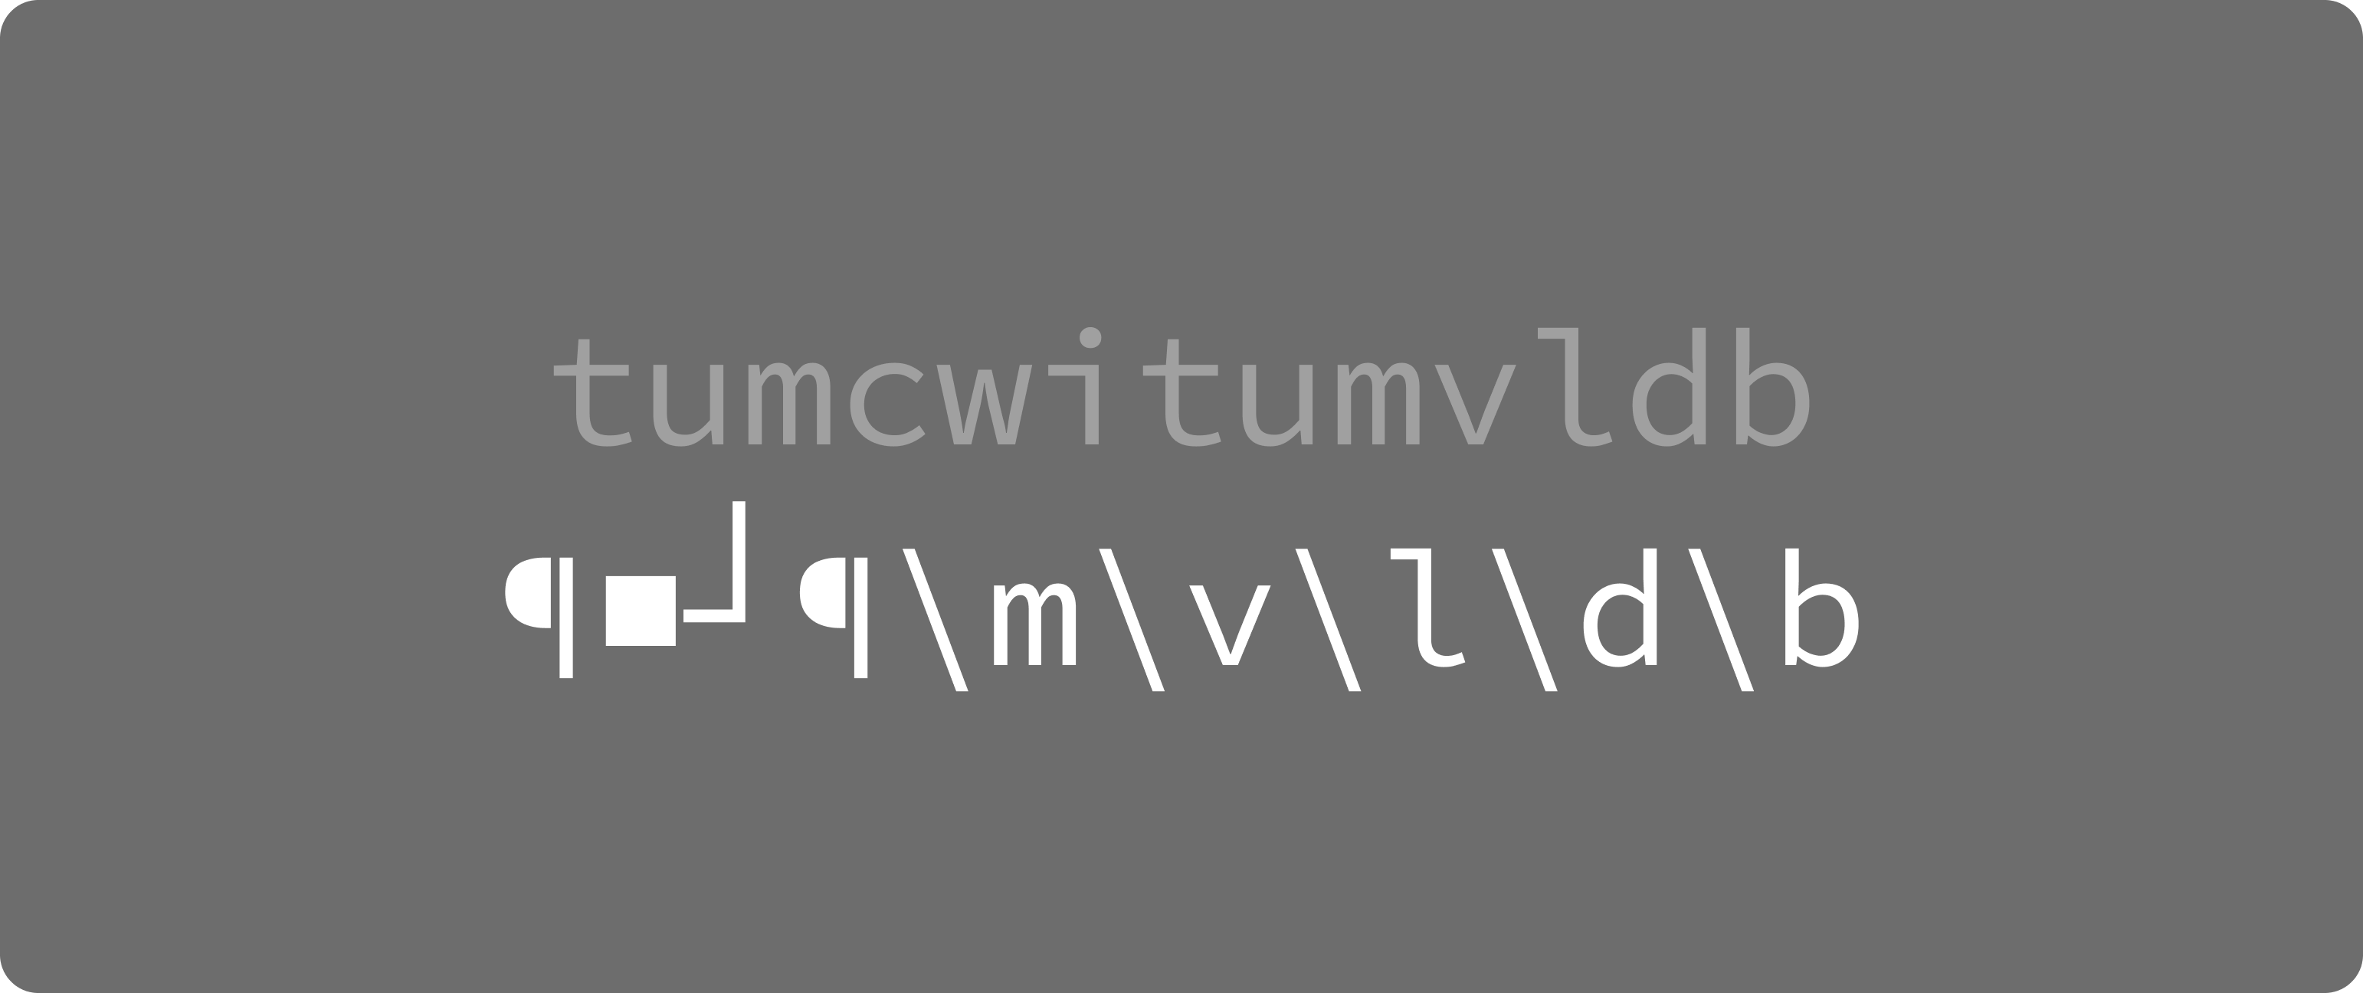
FSST – Symbol Table
Genetic-like bottom-up algorithm – MAX Symbol Size: 3, Symbol Table size: 5

Slide 29
FSST – Symbol Table
Genetic-like bottom-up algorithm – MAX Symbol Size: 3, Symbol Table size: 5
tumc

Slide 30
FSST – Symbol Table
Genetic-like bottom-up algorithm – MAX Symbol Size: 3, Symbol Table size: 5
mcwi
Notes:
This helps resolve dependency issue from before.

Slide 31
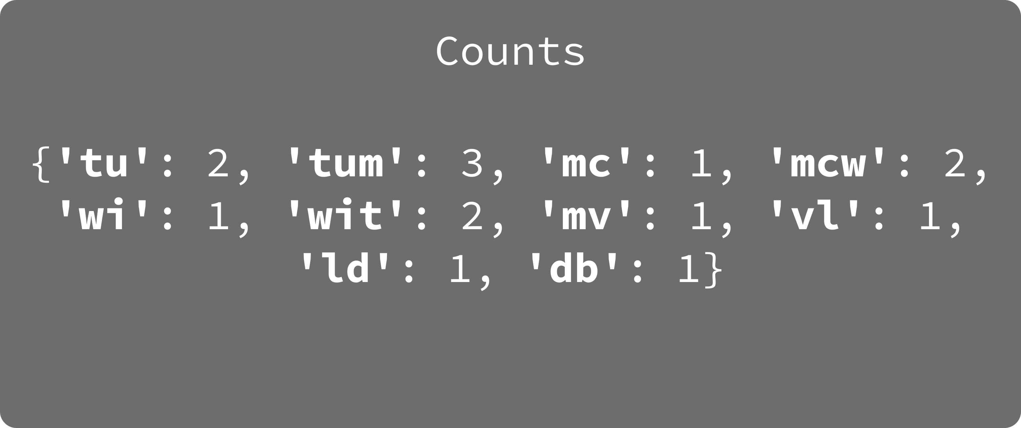
FSST – Symbol Table
Genetic-like bottom-up algorithm – MAX Symbol Size: 3, Symbol Table size: 5

Slide 32

FSST – Symbol Table
Genetic-like bottom-up algorithm – MAX Symbol Size: 3, Symbol Table size: 5

Slide 33
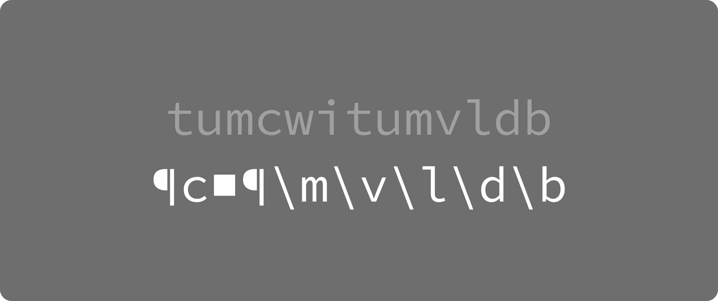
FSST – Symbol Table
Genetic-like bottom-up algorithm – MAX Symbol Size: 3, Symbol Table size: 5

Slide 34

FSST – Symbol Table
Genetic-like bottom-up algorithm – MAX Symbol Size: 3, Symbol Table size: 5
Generally, we optimize this process by using only a subset of the corpus – still reaching high compression.

Slide 35
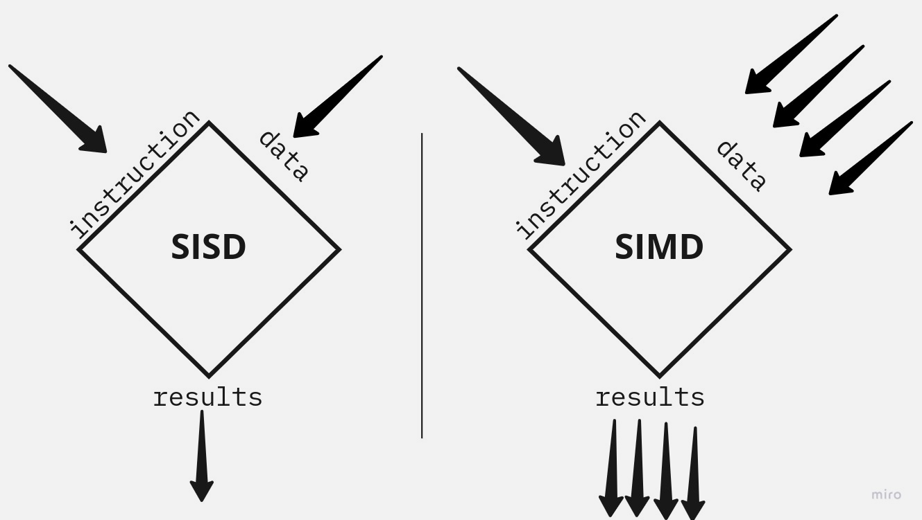
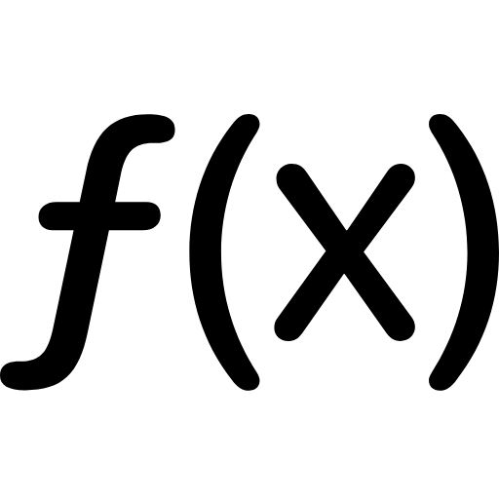
FSST – Optimizations
Lossy Perfect Hashing + Lookup Array
SIMD instruction parallelism (AVX512)
Notes:
Instead of using perfect hashing which incurs memory and multiple hash functions
Use lossy hashing, which allows them to discard symbol with lower gain if collision
Keep running algorithm until it reaches 255 symbols
Key – first 3 bytes of a symbol
Short code array to help SIMD work if the symbols are still of length 1 -2 bytes

Slide 36
FSST – Evaluation, LZ4 Review
Parameters:
Look-ahead buffer size: L
Search buffer size: S
Window size: L + S
LZ4 “Line”
Iteration direction
a | a | a | a | e | f
Search buffer
Look-ahead buffer
Problem: Bad compression ratio for short string.

Slide 37
FSST – Evaluation, LZ4 Review
LZ4 “Block”
Iteration direction
a | b | a | d | e | f | a | a | a | c | d | e | e | e
Search buffer
Look-ahead buffer
Problem: Cannot random read.

Slide 38
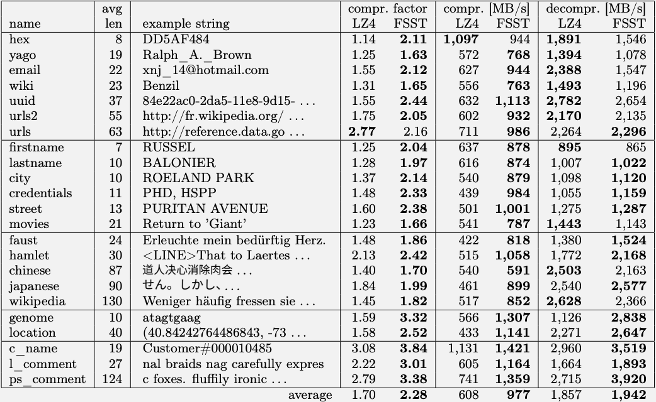

FSST – Evaluation, Compression
File mode (8MB)
Best case for LZ4
But what about LZ4’s worst case?

Slide 39
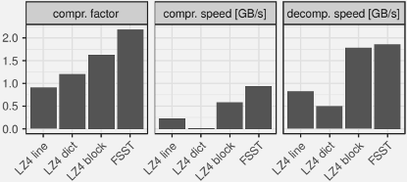
FSST – Evaluation, Compression
LZ4 line: A single string
LZ4 dict: Using a pre-generated optimal corpus dictionary
LZ4 block: Using grouped compression. 1,000 strings.

Slide 40
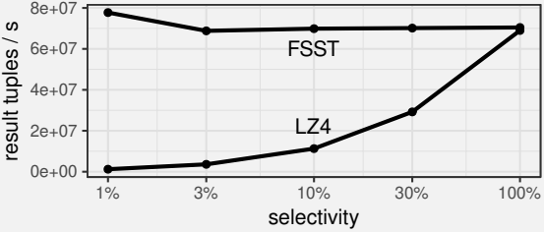
FSST – Evaluation, Random Access
When selecting only a subset of the values, one still has to decompress the whole block for LZ4, while FSST offers random access.
Does this mean FSST is a “silver bullet” solution?

Slide 41
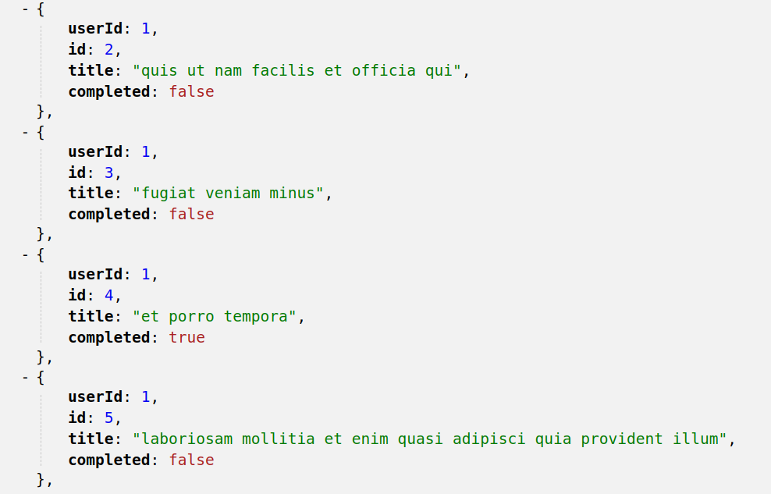
FSST – Evaluation
Notice the repetitive attributes.
Unfortunately not.
“FSST’s compression ratio on large XML and JSON files are 2-2.5x worse than LZ4.”
“However, we think database systems should store these composite values not as simple strings, but in a specialized type that allows query processing.”

Slide 42
FSST – Summary & Benefits
Small & light-weight Symbol Table
Support random access
Exploit frequent occurring substrings within the entire column level. Symbol table “learns” from the column set.
More performant for DB related workloads.
Future work:
Operations besides equality against the compressed String, to remove decompression overhead.
Hardware implementation of FSST (like MD5 or SHA-2).

Slide 43
FSST – Questions?

