Slide 1

Range Filtering at Orca Lab
Niv Dayan, Navid Eslami
CSC2525
Research Topics in Database Management

Slide 2


Problems?
SuRF
Rosetta

Slide 3
Problem 1: Dynamicity
SuRF
Rosetta

Slide 4
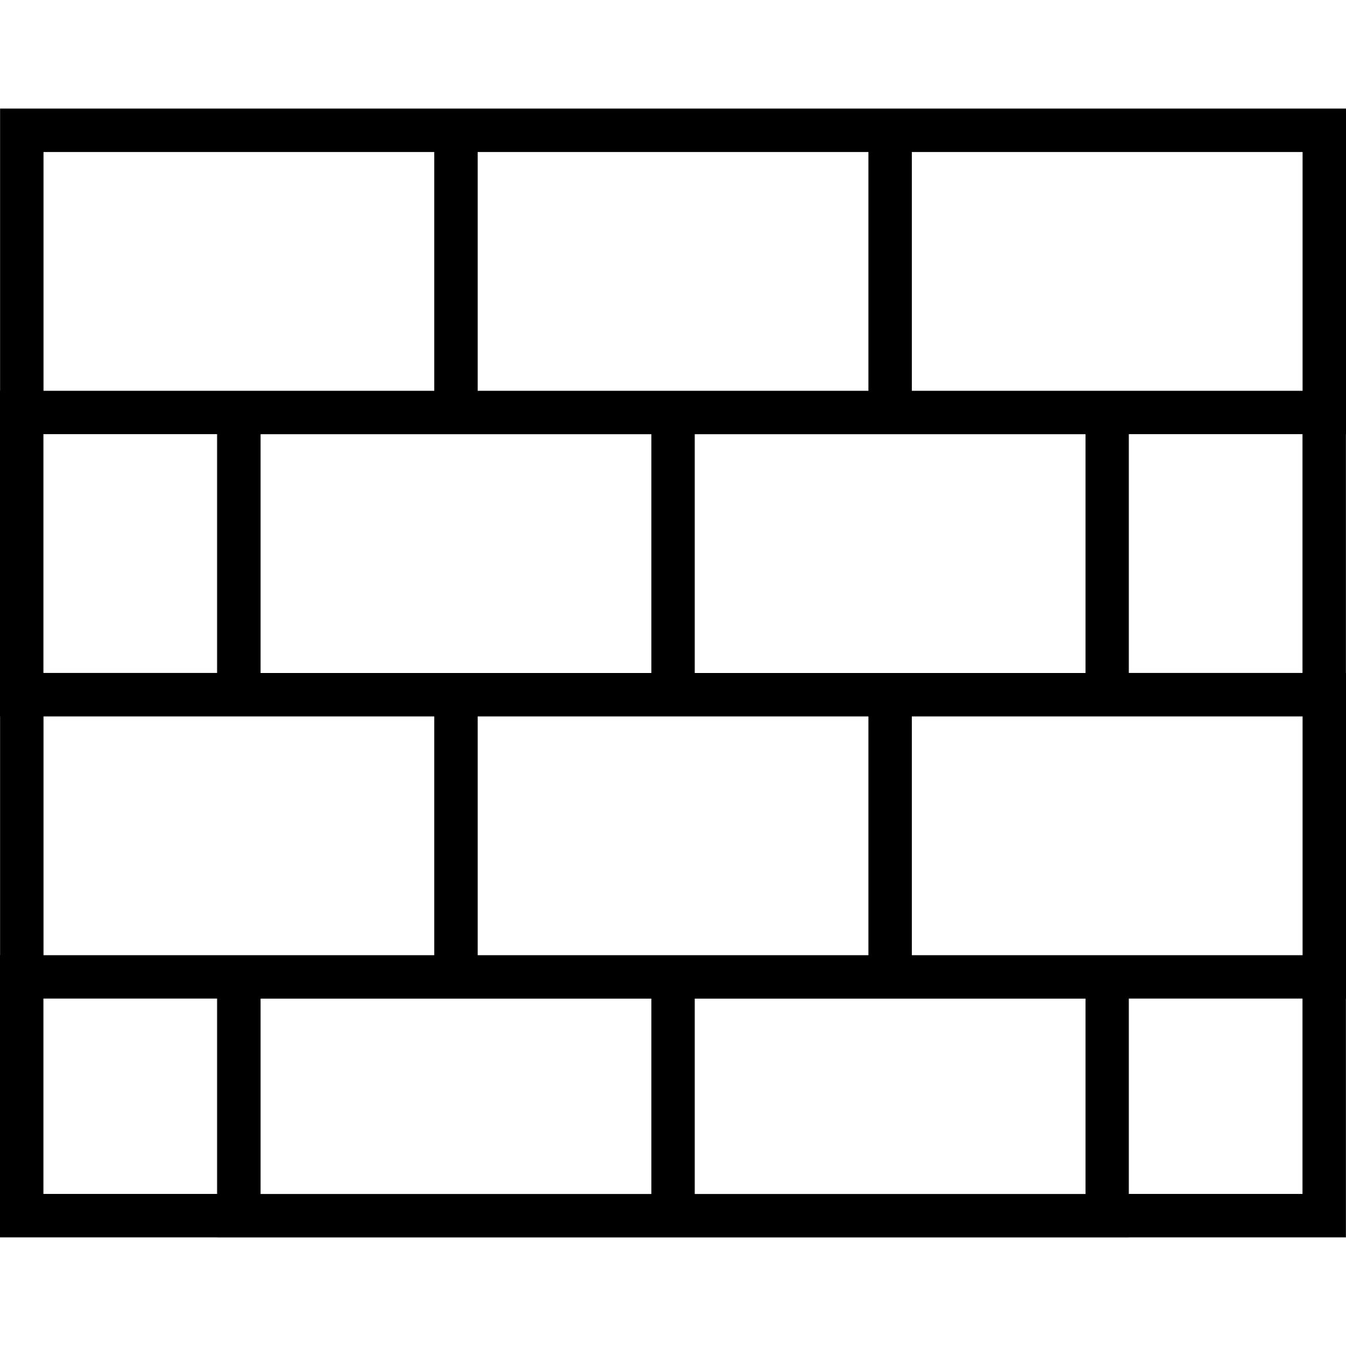
Problem 1: Dynamicity
SuRF
Rosetta
Static encoding

Slide 5

Problem 1: Dynamicity
SuRF
Rosetta
High FPR due to Saturation
Static encoding

Slide 6

Problem 1: Dynamicity
SuRF
Rosetta
High FPR due to Saturation
No deletes due to false negatives
Static encoding

Slide 7
Problem 2: Robustness
SuRF

Slide 8
Problem 2: Robustness
SuRF
A
B
C
D

Slide 9

Problem 2: Robustness
SuRF
A
B
C
D

Slide 10
Problem 2: Robustness
SuRF
A
B
C
[BA,BE]
D

Slide 11
Problem 2: Robustness
SuRF
A
B
C
[BA,BE]
True Positive
D

Slide 12
Problem 2: Robustness
SuRF
A
B
C
[BA,BE]
True Positive
D
[BE,BF]

Slide 13

Problem 2: Robustness
SuRF
A
B
C
[BA,BE]
True Positive
D
[BE,BF]
Missing necessary information for comparing BD and BE

Slide 14
Problem 2: Robustness
SuRF
A
B
C
[BA,BE]
True Positive
D
[BE,BF]
False Positive

Slide 15
Problem 2: Robustness
SuRF
A
B
C
[BA,BE]
True Positive
D
[BE,BF]
False Positive
[BEA,BF]

Slide 16
Problem 2: Robustness
SuRF
A
B
C
[BA,BE]
True Positive
D
[BE,BF]
False Positive
[BEA,BF]
False Positive

Slide 17
Problem 2: Robustness
SuRF
A
B
C
[BA,BE]
True Positive
D
[BE,BF]
False Positive
[BEA,BF]
False Positive
[BEB,BF]

Slide 18
Problem 2: Robustness
SuRF
A
B
C
[BA,BE]
True Positive
D
[BE,BF]
False Positive
[BEA,BF]
False Positive
[BEB,BF]
False Positive

Slide 19
Problem 2: Robustness
SuRF
A
B
C
[BA,BE]
True Positive
D
[BE,BF]
False Positive
[BEA,BF]
False Positive
[BEB,BF]
False Positive
...

Slide 20
Problem 2: Robustness
SuRF
A
B
C
D

Slide 21
Problem 2: Robustness
SuRF
A
B
C
D
Correlated Workload: Close keys and queries

Slide 22
Problem 2: Robustness
SuRF
A
B
C
D
Correlated Workload: Close keys and queries
High FPR for these common workloads

Slide 23
Problem 3: Speed
SuRF
Rosetta

Slide 24
Problem 3: Speed
SuRF
Rosetta
Traverse trie

Slide 25
Problem 3: Speed
SuRF
Rosetta
Traverse trie
One cache miss per level

Slide 26


Problem 3: Speed
SuRF
Rosetta
Traverse trie
One cache miss per level
Key length

Slide 27
Problem 3: Speed
SuRF
Rosetta
Traverse trie
Query Hierarchy
One cache miss per level
Key length

Slide 28
Problem 3: Speed
SuRF
Rosetta
Traverse trie
Query Hierarchy
One cache miss per level
Multiple cache misses per level
Key length

Slide 29
Problem 3: Speed
SuRF
Rosetta
Traverse trie
Query Hierarchy
One cache miss per level
Multiple cache misses per level
Key length
Hierarchy Depth

Slide 30
Problems?
SuRF

Slide 31



Robustness
Dynamicity
Speed
High FPR under certain common workloads
No inserts, deletes, and expansions
Poor cache locality

Slide 32
No range filter achieves all at the same time
Robustness
Dynamicity
Speed
High FPR under certain common workloads
No inserts, deletes, and expansions
Poor cache locality

Slide 33

Memento Filter
Robustness
Dynamicity
Speed

Slide 34
Assumptions
Universe

Slide 35
Assumptions
Finite universe (i.e., fixed-length keys)
Universe

Slide 36

Assumptions
Finite universe (i.e., fixed-length keys)
Range queries of length
Universe

Slide 37
Key Idea: Partition Universe
Universe

Slide 38
Key Idea: Partition Universe
Universe

Slide 39
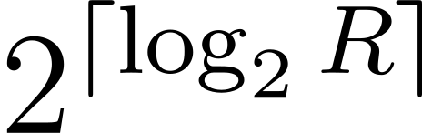
Key Idea: Partition Universe
Universe

Slide 40
Queries intersect at most 2 partitions
Universe

Slide 41
Queries intersect at most 2 partitions
Universe

Slide 42

Queries intersect at most 2 partitions
Compare offset of keys and query endpoints in a partition
Universe

Slide 43
Queries intersect at most 2 partitions
Compare offset of keys and query endpoints in a partition
Universe

Slide 44
Partition and Offset
Universe

Slide 45

Partition and Offset
Universe

Slide 46
Universe

Slide 47
Universe
Prefix
Memento

Slide 48
Universe
Prefix
Memento
Partition index

Slide 49
0
1
2
3
4
Universe
Prefix
Memento
Partition index

Slide 50
0
1
2
3
4
Universe
Prefix
Memento
Partition index
Offset

Slide 51

0
1
2
3
4
Universe
bits
Prefix
Memento
Partition index
Offset

Slide 52
0
1
2
3
4
Universe
Prefix
Memento
Partition index
Offset
Encode partitions and mementos in a Quotient filter

Slide 53
Storage Layout
0
1
2
3
4
Universe
QF

Slide 54
Storage Layout
0
1
2
3
4
Universe
QF

Slide 55
0
1
2
3
4
Universe
5
QF

Slide 56
0
1
2
3
4
Universe
5
Mementos:
QF

Slide 57
0
1
2
3
4
Universe
7
Mementos: 5
QF

Slide 58
0
1
2
3
4
Universe
8
Mementos: 5 7
QF

Slide 59
0
1
2
3
4
Universe
Mementos: 5 7 8
QF

Slide 60
0
1
2
3
4
Universe
Mementos: 5 7 8
Hash partition index to a run
QF

Slide 61
0
1
2
3
4
Universe
Mementos: 5 7 8
Hash partition index to a run
Store partition index fingerprint
QF
FP(2)

Slide 62
0
1
2
3
4
Universe
Mementos: 5 7 8
Hash partition index to a run
Store partition index fingerprint
along with memento list
QF
FP(2)

Slide 63
0
1
2
3
4
Universe
Hash partition index to a run
Store partition index fingerprint
along with memento list
QF
FP(2)
5 7 8

Slide 64


0
1
2
3
4
Universe
Hash partition index to a run
Store partition index fingerprint
along with memento list
QF

Slide 65
0
1
2
3
4
Universe
Hash partition index to a run
Store partition index fingerprint
along with memento list
Keepsake Box
QF

Slide 66
Inserts
Universe
QF

Slide 67
Inserts
Universe
QF
Cluster
Run
Keepsake Box

Slide 68
Inserts
Universe
Find/Create keepsake box
Add memento
QF

Slide 69
Inserts
Universe
Find/Create keepsake box
Add memento
QF

Slide 70
Inserts
Universe
Find/Create keepsake box
Add memento
QF

Slide 71
Deletes
Universe
QF

Slide 72
Deletes
Universe
Find keepsake box with matching fingerprint
Remove memento
QF

Slide 73
Deletes
Universe
Find keepsake box with matching fingerprint
Remove memento
Potentially destroy keepsake box
QF

Slide 74
Deletes
Universe
Find keepsake box with matching fingerprint
Remove memento
Potentially destroy keepsake box
QF

Slide 75
Deletes
Universe
Find keepsake box with matching fingerprint
Remove memento
Potentially destroy keepsake box
QF

Slide 76
Queries
Universe
QF

Slide 77
Queries
Universe
QF

Slide 78
Queries
Universe
Find keepsake boxes of overlapping partitions
QF

Slide 79
Queries
Universe
QF

Slide 80
Queries
Universe
QF

Slide 81
Queries
Universe
QF

Slide 82
Queries
Universe
QF
Compare mementos and query endpoints to check for inclusion

Slide 83

Queries
Universe
QF
False positives due to fingerprint collisions

Slide 84
Delimiting Keepsake Boxes
QF

Slide 85

Delimiting Keepsake Boxes
Multiple keepsake boxes in a run
QF

Slide 86

Multiple keepsake boxes in a run
Delimit to decode unambiguously
QF

Slide 87

Multiple keepsake boxes in a run
Delimit to decode unambiguously
Simple solution: special character after the last slot
QF

Slide 88

Multiple keepsake boxes in a run
Delimit to decode unambiguously
Simple solution: special character after the last slot
Expensive!
QF

Slide 89

Self Delimiting Encoding: Minimize metadata overhead
QF

Slide 90
Self Delimiting Encoding: Minimize metadata overhead
Store keepsake boxes in a run in increasing fingerprint order
QF

Slide 91
Self Delimiting Encoding: Minimize metadata overhead
Store keepsake boxes in a run in increasing fingerprint order
Allows space efficiency!
QF

Slide 92
Slot Structure
QF
Slot

Slide 93

Slot Structure
QF
Slot

Slide 94
Encoding Keepsake Boxes
Partition in Universe
...
...

Slide 95
Size=1
Partition in Universe
...
...

Slide 96
Size=1
Partition in Universe
...
...

Slide 97
Size=1
Partition in Universe
...
...

Slide 98
Size=1
Partition in Universe
...
...
Example
10110
100

Slide 99
Size=1
Partition in Universe
...
...
Example
10110
100
11111
...

Slide 100
Size=1
Partition in Universe
...
...
Example
10110
100
11111
...

Slide 101
Size=1
Partition in Universe
...
...

Slide 102
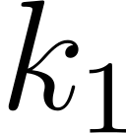
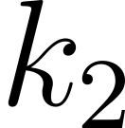
Size=2
Partition in Universe
...
...

Slide 103
Size=2
Partition in Universe
...
...

Slide 104

Size=2
Partition in Universe
...
...

Slide 105

Size=2
Partition in Universe
...
...

Slide 106
Size=2
Partition in Universe
...
...
Example
10110
011
10110
101

Slide 107
Size=2
Partition in Universe
...
...
Example
10110
011
10110
101
11111
...

Slide 108
Size=2
Partition in Universe
...
...
Example
10110
011
10110
101
11111
...

Slide 109
Size=2
Partition in Universe
...
...

Slide 110


Size=
Partition in Universe
...
...
...

Slide 111
Size=
Partition in Universe
...
...
...
Cut down encoding length

Slide 112
Size=
Partition in Universe
...
...
...
Cut down encoding length
No duplicate fingerprints

Slide 113
Size=
Partition in Universe
...
...
...
0

Slide 114

Size=
Partition in Universe
...
...
...
Zero fingerprint as escape sequence
0

Slide 115
Size=
Partition in Universe
...
...
...
0

Slide 116

Size=
Partition in Universe
...
...
...
0

Slide 117
Size=
Partition in Universe
...
...
...
0

Slide 118

Size=
Partition in Universe
...
...
...
Fast access to max/min
0

Slide 119
Size=
Partition in Universe
...
...
...
Speed up queries
0

Slide 120
Size=
Partition in Universe
...
...
...
Sorted List of other mementos
0

Slide 121
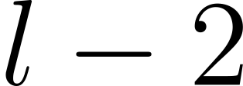
Size=
Partition in Universe
...
...
...
0

Slide 122
Size=
Partition in Universe
...
...
...
0
bit
length field

Slide 123

Size=
Partition in Universe
...
...
...
0
...

Slide 124
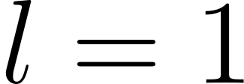
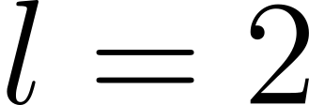
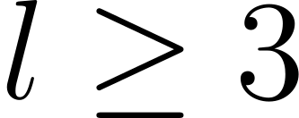
Encoding Keepsake Boxes: Summary
0
...

Slide 125
0
...

Slide 126
Delimited by fingerprint order invariant
0
...

Slide 127
Delimited by fingerprint order invariant
0
...
Delimited by length field

Slide 128
Range Queries
Universe

Slide 129
Range Queries
Universe
Focus on the case of long keepsake boxes
0
...

Slide 130
Case 1: Single Partition
Universe
0
...

Slide 131
Case 1: Single Partition
Universe
Find predecessor memento of right endpoint
0
...

Slide 132
Case 1: Single Partition
Universe
Find predecessor memento of right endpoint
0
...

Slide 133
Case 1: Single Partition
Universe
Find predecessor memento of right endpoint
0
...
Binary Search

Slide 134
Case 1: Single Partition
Universe
0
...

Slide 135
Case 2: Two Partitions
Universe
0
...

Slide 136
Case 2: Two Partitions
Universe
First partition
0
...
Second partition
0
...

Slide 137
Case 2: Two Partitions
Universe
Max of first partition
Min of second partition
First partition
0
...
Second partition
0
...

Slide 138
Case 2: Two Partitions
Universe
Max of first partition
Min of second partition
First partition
0
...
Second partition
0
...

Slide 139
Case 2: Two Partitions
Universe
First partition
0
...
Second partition
0
...

Slide 140
Point Queries
Universe
0
...

Slide 141
Point Queries
Universe
Find memento equal to query
0
...

Slide 142
Point Queries
Universe
Find memento equal to query
0
...

Slide 143
Point Queries
Universe
Find memento equal to query
0
...
Binary Search

Slide 144
Analysis

Slide 145
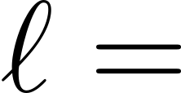
Analysis
Avg. number of keys in a non-empty partition

Slide 146

Analysis
Avg. number of keys in a non-empty partition
Filter’s load factor (# keys / # slots)

Slide 147

Analysis
Avg. number of keys in a non-empty partition
Filter’s load factor (# keys / # slots)
False positives only due to fingerprint collisions of partitions

Slide 148
Analysis
Avg. number of keys in a non-empty partition
Filter’s load factor (# keys / # slots)
FPR

Slide 149
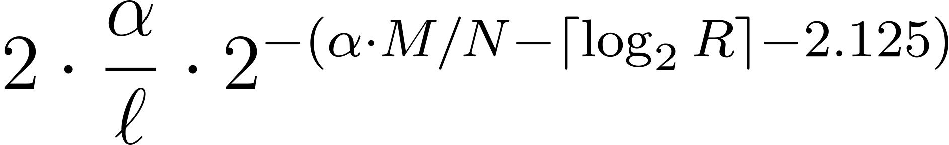
Analysis
Avg. number of keys in a non-empty partition
Filter’s load factor (# keys / # slots)
FPR

Slide 150
Analysis
Avg. number of keys in a non-empty partition
Filter’s load factor (# keys / # slots)
FPR
Bits per entry budget

Slide 151
Analysis
Avg. number of keys in a non-empty partition
Filter’s load factor (# keys / # slots)
FPR
Affordable slot size

Slide 152
Analysis
Avg. number of keys in a non-empty partition
Filter’s load factor (# keys / # slots)
FPR
Memento size

Slide 153
Analysis
Avg. number of keys in a non-empty partition
Filter’s load factor (# keys / # slots)
FPR
Metadata overhead
(Rank and Select Quotient Filter)

Slide 154
Analysis
Avg. number of keys in a non-empty partition
Filter’s load factor (# keys / # slots)
FPR
Fingerprint length

Slide 155
Analysis
Avg. number of keys in a non-empty partition
Filter’s load factor (# keys / # slots)
FPR
Collision probability

Slide 156
Analysis
Avg. number of keys in a non-empty partition
Filter’s load factor (# keys / # slots)
FPR
Avg. # of keepsake boxes per slot

Slide 157
Analysis
Avg. number of keys in a non-empty partition
Filter’s load factor (# keys / # slots)
FPR
Overhead of checking two partitions

Slide 158
Analysis
Avg. number of keys in a non-empty partition
Filter’s load factor (# keys / # slots)
FPR
Expected Cluster Size

Slide 159

Analysis
Avg. number of keys in a non-empty partition
Filter’s load factor (# keys / # slots)
FPR
Expected Cluster Size

Slide 160
Analysis
Avg. number of keys in a non-empty partition
Filter’s load factor (# keys / # slots)
FPR
Expected Cluster Size
A bit complicated, see the paper!

Slide 161
Analysis
Avg. number of keys in a non-empty partition
Filter’s load factor (# keys / # slots)
FPR
Expected Cluster Size

Slide 162
Analysis
Avg. number of keys in a non-empty partition
Filter’s load factor (# keys / # slots)
FPR
Expected Cluster Size
Insert/Delete

Slide 163
Analysis
Avg. number of keys in a non-empty partition
Filter’s load factor (# keys / # slots)
FPR
Expected Cluster Size
Insert/Delete
Range Query: Single

Slide 164
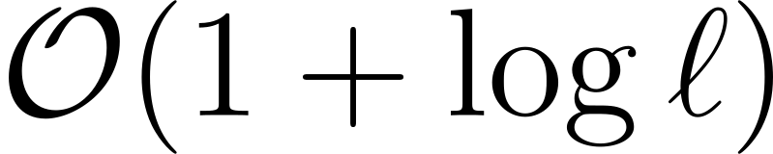
Analysis
Avg. number of keys in a non-empty partition
Filter’s load factor (# keys / # slots)
FPR
Expected Cluster Size
Insert/Delete
Range Query: Single

Slide 165
Analysis
Avg. number of keys in a non-empty partition
Filter’s load factor (# keys / # slots)
FPR
Expected Cluster Size
Insert/Delete
Range Query: Single
Finding run, skipping over keepsake boxes

Slide 166
Analysis
Avg. number of keys in a non-empty partition
Filter’s load factor (# keys / # slots)
FPR
Expected Cluster Size
Insert/Delete
Range Query: Single
Keepsake box binary search

Slide 167
Analysis
Avg. number of keys in a non-empty partition
Filter’s load factor (# keys / # slots)
FPR
Expected Cluster Size
Insert/Delete
Range Query: Single
Just one random cache miss!

Slide 168
Analysis
Avg. number of keys in a non-empty partition
Filter’s load factor (# keys / # slots)
FPR
Expected Cluster Size
Insert/Delete
Range Query: Single
Just one random cache miss!
Range Query: Two

Slide 169

Analysis
Avg. number of keys in a non-empty partition
Filter’s load factor (# keys / # slots)
FPR
Expected Cluster Size
Insert/Delete
Range Query: Single
Just one random cache miss!
Range Query: Two

Slide 170
Analysis
Avg. number of keys in a non-empty partition
Filter’s load factor (# keys / # slots)
FPR
Expected Cluster Size
Insert/Delete
Range Query: Single
Just one random cache miss!
Range Query: Two
Just two random cache misses!

Slide 171
Problems?

Slide 172

No variable-length keys

Slide 173
Ambiguous splitting of keys into prefixes and memento
No variable-length keys

Slide 174
Ambiguous splitting of keys into prefixes and memento
No variable-length keys

Slide 175
Ambiguous splitting of keys into prefixes and memento
No variable-length keys

Slide 176
No variable-length keys

Slide 177
No variable-length keys
Bounded range query length ‌‌

Slide 178
No variable-length keys
Bounded range query length ‌‌
Fixed-length mementos

Slide 179
No variable-length keys
Bounded range query length ‌‌

Slide 180

No variable-length keys
Variable-length keys imply infinitely many keys in any range, i.e., ‌
Bounded range query length ‌‌

Slide 181
No variable-length keys
Bounded range query length ‌‌
Question
Can we design a robust and dynamic range filter that resolves these issues?

Slide 182

No variable-length keys
Bounded range query length ‌‌
Question
Can we design a robust and dynamic range filter that resolves these issues?
NO

Slide 183

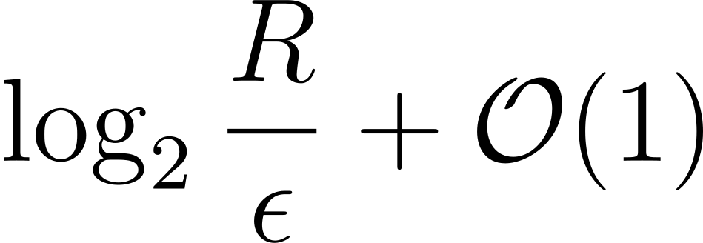
Theorem: Robust range filters need at least bits per key

Slide 184
Theorem: Robust range filters need at least bits per key
Max range size

Slide 185
Theorem: Robust range filters need at least bits per key
FPR

Slide 186
Theorem: Robust range filters need at least bits per key
Memento filter

Slide 187
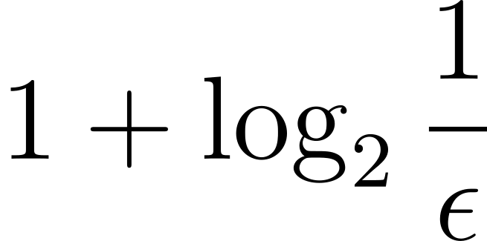
Theorem: Robust range filters need at least bits per key
Fingerprints of size
Memento filter

Slide 188

Theorem: Robust range filters need at least bits per key
Fingerprints of size
Memento filter
Mementos of size

Slide 189

Theorem: Robust range filters need at least bits per key
Fingerprints of size
Memento filter
Mementos of size

Slide 190

Any way out?

Slide 191
Robustness

Slide 192

Robustness
Semi-Robustness

Slide 193

Semi-Robustness
Guarantee an FPR of for “common” datasets

Slide 194
Semi-Robustness
Guarantee an FPR of for “common” datasets
Disregard worst-case ones!

Slide 195

Diva

Slide 196
Diva
Semi-Robustness
Dynamicity
Speed
Variable-length keys and queries

Slide 197
Structure Overview

Slide 198
Structure Overview
Static case
Dynamic case

Slide 199
Structure Overview
Static case

Slide 200

Structure Overview
Learn the dataset distribution

Slide 201
Sorted set of keys

Slide 202

Sorted set of keys
Sample every -th key

Slide 203
Sorted set of keys
Sample every -th key

Slide 204
1024
Sorted set of keys
Sample every -th key

Slide 205

Sorted set of keys
Store the samples in a small trie

Slide 206
Sorted set of keys
Store the samples in a small trie

Slide 207
Sorted set of keys
Sketch keys in-between samples

Slide 208
Sorted set of keys
Sketch keys in-between samples
Store sketches in Infix Stores

Slide 209
Range Queries

Slide 210
Range Queries

Slide 211
Range Queries
Check if a sample in the trie is in the range

Slide 212
Range Queries
Check if a sample in the trie is in the range
If yes, true positive

Slide 213
Range Queries
Check if a sample in the trie is in the range
If yes, true positive

Slide 214
Range Queries
Otherwise, range lies in-between two samples, i.e., in an Infix Store

Slide 215
Range Queries
Otherwise, range lies in-between two samples, i.e., in an Infix Store
Query Infix Store

Slide 216
Range Queries
Otherwise, range lies in-between two samples, i.e., in an Infix Store
Query Infix Store
May return a false positive due to sketching

Slide 217
Sketching Keys

Slide 218
Sketching Keys
A
B

Slide 219
Sketching Keys
A
B

Slide 220
Sketching Keys
A
B

Slide 221
Sketching Keys
A
B

Slide 222
Sketching Keys
A
B

Slide 223
More Significant
A
B
Bits
Less Significant
Lexical Ordering
Smaller
Larger

Slide 224
A
B
Key

Slide 225
A
0
1
0
1
1
0
0
0
0
0
1
0
1
0
1
0
1
1
1
1
0
1
0
1
1
0
B
Key

Slide 226
Predecessor
Successor
0
1
0
1
1
0
0
0
0
0
1
0
1
0
1
0
1
1
1
1
0
1
0
1
1
0
Key

Slide 227
Predecessor
0
1
0
1
1
Successor
0
1
0
1
1
0
0
0
0
0
1
0
1
0
1
0
1
1
1
1
0
1
0
1
1
0
Longest Common Prefix
Key

Slide 228
Predecessor
0
1
0
1
1
Successor
0
1
0
1
1
0
0
0
0
0
1
0
1
0
1
0
1
1
1
1
0
1
0
1
1
0
Longest Common Prefix
Already encoded in trie
Key

Slide 229

Predecessor
0
1
0
1
1
Successor
0
1
0
1
1
0
0
0
0
0
1
0
1
0
1
0
1
1
1
1
0
1
0
1
1
0
Longest Common Prefix
Key

Slide 230
Predecessor
Successor
0
1
0
1
1
0
0
0
0
0
1
0
1
0
1
0
1
1
1
1
0
1
0
1
1
0
Key

Slide 231
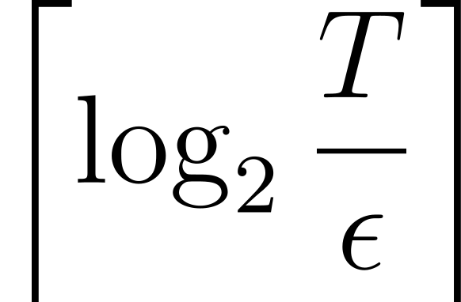
Predecessor
Successor
0
1
0
1
1
0
0
0
0
0
1
0
1
0
1
0
1
1
1
1
0
1
0
1
1
0
bits
Key

Slide 232
Predecessor
Successor
0
1
0
1
1
0
0
0
0
0
1
0
1
0
1
0
1
1
1
1
0
1
0
1
1
0
bits
Key

Slide 233
Predecessor
Successor
0
1
0
1
1
0
0
0
0
0
1
0
1
0
1
0
1
1
1
1
0
1
0
1
1
0
bits
Infix

Slide 234
Predecessor
Successor
0
1
0
1
1
0
0
0
0
0
1
0
1
0
1
0
1
1
1
1
0
1
0
1
1
0
bits
Infix

Slide 235
Infix Properties
Infix

Slide 236
Infix
CDF
Keys
Observation:
In smooth distributions, keys in-between samples are uniformly distributed

Slide 237
Infix
CDF
Keys
Observation:
In smooth distributions, keys in-between samples are uniformly distributed

Slide 238
Infix
CDF
Keys
Observation:
In smooth distributions, keys in-between samples are uniformly distributed

Slide 239

Infix
Uniformly Distributed

Slide 240

Infix
Uniformly Distributed
Order-Preserving

Slide 241
Infix
Like an order-preserving hash

Slide 242

Infix
Like an order-preserving hash
A total of possible hash values

Slide 243
Infix
Like an order-preserving hash
A total of possible hash values
Small technical tweaks needed (details in the paper)

Slide 244
Infix Store

Slide 245

Infix Store
Similar to a Rank and Select Quotient filter

Slide 246
Infix Quotienting
Infix

Slide 247
Infix Quotienting
More Significant
Less Significant
Infix

Slide 248
Infix Quotienting
Infix

Slide 249

Infix Quotienting
Quotient
Infix

Slide 250
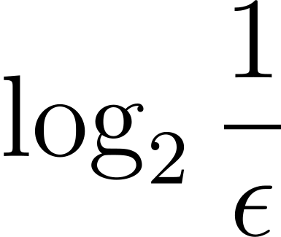
Infix Quotienting
Quotient
Remainder
Infix

Slide 251
Infix Quotienting
Quotient
Remainder (Fingerprint)
Infix

Slide 252
Infix Store
0
0
0
1
1
1
0
Infix 1

Slide 253
Infix Store
0
0
0
1
1
1
0
Infix 1
0
1
2
3
4
5
6
7
Occupieds
0
0
0
0
0
0
0
0

Slide 254
Infix Store
0
0
0
1
1
1
0
Infix 1
0
1
2
3
4
5
6
7
Occupieds
0
0
0
0
0
0
0
0

Slide 255
Infix Store
0
0
0
1
1
1
0
Infix 1
0
1
2
3
4
5
6
7
Occupieds
1
0
0
0
0
0
0
0

Slide 256
Infix Store
0
0
0
1
1
1
0
Infix 1
0
1
2
3
4
5
6
7
Occupieds
1
0
0
0
0
0
0
0

Slide 257
Infix Store
0
0
0
1
1
1
0
Infix 1
0
1
2
3
4
5
6
7
Occupieds
1
0
0
0
0
0
0
0
Slots

Slide 258
Infix Store
0
0
0
1
1
1
0
Infix 1
0
1
2
3
4
5
6
7
Occupieds
1
0
0
0
0
0
0
0
Slots
1110

Slide 259
0
0
0
1
1
1
0
0
1
0
0
0
1
0
Infix 2
0
1
2
3
4
5
6
7
Occupieds
1
0
0
0
0
0
0
0
Slots
1110

Slide 260
0
0
0
1
1
1
0
0
1
0
0
0
1
0
Infix 2
0
1
2
3
4
5
6
7
Occupieds
1
0
0
0
0
0
0
0
Slots
1110

Slide 261
0
0
0
1
1
1
0
0
1
0
0
0
1
0
Infix 2
0
1
2
3
4
5
6
7
Occupieds
1
0
1
0
0
0
0
0
Slots
1110

Slide 262
0
0
0
1
1
1
0
0
1
0
0
0
1
0
Infix 2
0
1
2
3
4
5
6
7
Occupieds
1
0
1
0
0
0
0
0
Slots
1110

Slide 263
0
0
0
1
1
1
0
0
1
0
0
0
1
0
Infix 2
0
1
2
3
4
5
6
7
Occupieds
1
0
1
0
0
0
0
0
Slots
1110
0010

Slide 264
0
0
0
1
1
1
0
0
1
0
0
0
1
0
0
1
0
0
1
1
0
Infix 3
0
1
2
3
4
5
6
7
Occupieds
1
0
1
0
0
0
0
0
Slots
1110
0010

Slide 265
0
0
0
1
1
1
0
0
1
0
0
0
1
0
0
1
0
0
1
1
0
Infix 3
0
1
2
3
4
5
6
7
Occupieds
1
0
1
0
0
0
0
0
Slots
1110
0010

Slide 266
0
0
0
1
1
1
0
0
1
0
0
0
1
0
0
1
0
0
1
1
0
Infix 3
0
1
2
3
4
5
6
7
Occupieds
1
0
1
0
0
0
0
0
Slots
1110
0010
0110

Slide 267

0
0
0
1
1
1
0
0
1
0
0
0
1
0
0
1
0
0
1
1
0
Remainders of infixes sharing quotients are stored contiguously in runs
0
1
2
3
4
5
6
7
Occupieds
1
0
1
0
0
0
0
0
Slots
1110
0010
0110

Slide 268
0
0
0
1
1
1
0
0
1
0
0
0
1
0
0
1
0
0
1
1
0
Remainders of infixes sharing quotients are stored contiguously in runs
0
1
2
3
4
5
6
7
Occupieds
1
0
1
0
0
0
0
0
Slots
1110
0010
0110

Slide 269
Remainders of infixes sharing quotients are stored contiguously in runs
0
1
2
3
4
5
6
7
Occupieds
1
0
1
1
0
1
0
1
Slots
1110
0010
0110
0000
0010
1010
0001

Slide 270
Remainders of infixes sharing quotients are stored contiguously in runs
0
1
2
3
4
5
6
7
Occupieds
1
0
1
1
0
1
0
1
Slots
1110
0010
0110
0000
0010
1010
0001

Slide 271
Remainders of infixes sharing quotients are stored contiguously in runs
0
1
2
3
4
5
6
7
Occupieds
1
0
1
1
0
1
0
1
Runends
Slots
1110
0010
0110
0000
0010
1010
0001

Slide 272
Remainders of infixes sharing quotients are stored contiguously in runs
0
1
2
3
4
5
6
7
Occupieds
1
0
1
1
0
1
0
1
Runends
1
0
1
0
1
1
1
Slots
1110
0010
0110
0000
0010
1010
0001

Slide 273
Remainders of infixes sharing quotients are stored contiguously in runs
0
1
2
3
4
5
6
7
Occupieds
1
0
1
1
0
1
0
1
Runends
1
0
1
0
1
1
1
Slots
1110
0010
0110
0000
0010
1010
0001

Slide 274

Matching 1 bits
0
1
2
3
4
5
6
7
Occupieds
1
0
1
1
0
1
0
1
Runends
1
0
1
0
1
1
1
Slots
1110
0010
0110
0000
0010
1010
0001

Slide 275
Matching 1 bits
0
1
2
3
4
5
6
7
Occupieds
1
0
1
1
0
1
0
1
Runends
1
0
1
0
1
1
1
Slots
1110
0010
0110
0000
0010
1010
0001

Slide 276
Matching 1 bits
Matching 1s have equal rank
0
1
2
3
4
5
6
7
Occupieds
1
0
1
1
0
1
0
1
Runends
1
0
1
0
1
1
1
Slots
1110
0010
0110
0000
0010
1010
0001

Slide 277
Matching 1 bits
Locate using rank and select
0
1
2
3
4
5
6
7
Occupieds
1
0
1
1
0
1
0
1
Runends
1
0
1
0
1
1
1
Slots
1110
0010
0110
0000
0010
1010
0001

Slide 278
Efficient CPU implementation
0
1
2
3
4
5
6
7
Occupieds
1
0
1
1
0
1
0
1
Runends
1
0
1
0
1
1
1
Slots
1110
0010
0110
0000
0010
1010
0001

Slide 279
Range Queries
0
1
2
3
4
5
6
7
Occupieds
1
0
1
1
0
1
0
1
Runends
1
0
1
0
1
1
1
Slots
1110
0010
0110
0000
0010
1010
0001

Slide 280

Sketch endpoint keys
0
1
2
3
4
5
6
7
Occupieds
1
0
1
1
0
1
0
1
Runends
1
0
1
0
1
1
1
Slots
1110
0010
0110
0000
0010
1010
0001

Slide 281
Sketch endpoint keys
Left
Right
0
1
2
3
4
5
6
7
Occupieds
1
0
1
1
0
1
0
1
Runends
1
0
1
0
1
1
1
Slots
1110
0010
0110
0000
0010
1010
0001

Slide 282
Quotient cases:
Left
Right
0
1
2
3
4
5
6
7
Occupieds
1
0
1
1
0
1
0
1
Runends
1
0
1
0
1
1
1
Slots
1110
0010
0110
0000
0010
1010
0001

Slide 283
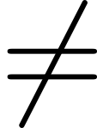

Quotient cases:
Left
Right
0
1
2
3
4
5
6
7
Occupieds
1
0
1
1
0
1
0
1
Runends
1
0
1
0
1
1
1
Slots
1110
0010
0110
0000
0010
1010
0001

Slide 284
0
1
0
0
0
1
1
0
1
0
0
1
0
1
Left
Right
0
1
2
3
4
5
6
7
Occupieds
1
0
1
1
0
1
0
1
Runends
1
0
1
0
1
1
1
Slots
1110
0010
0110
0000
0010
1010
0001

Slide 285
0
1
0
0
0
1
1
0
1
0
0
1
0
1
Left
Right
0
1
2
3
4
5
6
7
Occupieds
1
0
1
1
0
1
0
1
Runends
1
0
1
0
1
1
1
Slots
1110
0010
0110
0000
0010
1010
0001

Slide 286
0
1
0
0
0
1
1
0
1
0
0
1
0
1
Left
Right
0
1
2
3
4
5
6
7
Occupieds
1
0
1
1
0
1
0
1
Runends
1
0
1
0
1
1
1
Slots
1110
0010
0110
0000
0010
1010
0001

Slide 287
0
1
0
0
0
1
1
0
1
0
0
1
0
1
Left
Right
0
1
2
3
4
5
6
7
Occupieds
1
0
1
1
0
1
0
1
Runends
1
0
1
0
1
1
1
Slots
1110
0010
0110
0000
0010
1010
0001
Scan for inclusion between endpoint remainders

Slide 288
0
1
0
0
0
1
1
0
1
0
0
1
0
1
Left
Right
0
1
2
3
4
5
6
7
Occupieds
1
0
1
1
0
1
0
1
Runends
1
0
1
0
1
1
1
Slots
1110
0010
0110
0000
0010
1010
0001
Negative

Slide 289
0
1
0
0
0
1
1
0
1
0
0
1
0
1
Left
Right
0
1
2
3
4
5
6
7
Occupieds
1
0
1
1
0
1
0
1
Runends
1
0
1
0
1
1
1
Slots
1110
0010
0110
0000
0010
1010
0001

Slide 290
0
1
0
1
1
0
1
1
0
0
1
1
1
1
Left
Right
0
1
2
3
4
5
6
7
Occupieds
1
0
1
1
0
1
0
1
Runends
1
0
1
0
1
1
1
Slots
1110
0010
0110
0000
0010
1010
0001

Slide 291
0
1
0
1
1
0
1
1
0
0
1
1
1
1
Left
Right
0
1
2
3
4
5
6
7
Occupieds
1
0
1
1
0
1
0
1
Runends
1
0
1
0
1
1
1
Slots
1110
0010
0110
0000
0010
1010
0001

Slide 292
0
1
0
1
1
0
1
1
0
0
1
1
1
1
Left
Right
0
1
2
3
4
5
6
7
Occupieds
1
0
1
1
0
1
0
1
Runends
1
0
1
0
1
1
1
Slots
1110
0010
0110
0000
0010
1010
0001

Slide 293
0
1
0
1
1
0
1
1
0
0
1
1
1
1
Left
Right
0
1
2
3
4
5
6
7
Occupieds
1
0
1
1
0
1
0
1
Runends
1
0
1
0
1
1
1
Slots
1110
0010
0110
0000
0010
1010
0001
Run strictly in range

Slide 294
0
1
0
1
1
0
1
1
0
0
1
1
1
1
Left
Right
0
1
2
3
4
5
6
7
Occupieds
1
0
1
1
0
1
0
1
Runends
1
0
1
0
1
1
1
Slots
1110
0010
0110
0000
0010
1010
0001
Run strictly in range
True Positive

Slide 295
0
1
0
1
1
0
1
1
0
0
1
1
1
1
Left
Right
0
1
2
3
4
5
6
7
Occupieds
1
0
1
1
0
1
0
1
Runends
1
0
1
0
1
1
1
Slots
1110
0010
0110
0000
0010
1010
0001

Slide 296
0
0
0
1
1
1
1
0
1
0
0
0
0
1
Left
Right
0
1
2
3
4
5
6
7
Occupieds
1
0
1
1
0
1
0
1
Runends
1
0
1
0
1
1
1
Slots
1110
0010
0110
0000
0010
1010
0001

Slide 297
0
0
0
1
1
1
1
0
1
0
0
0
0
1
Left
Right
0
1
2
3
4
5
6
7
Occupieds
1
0
1
1
0
1
0
1
Runends
1
0
1
0
1
1
1
Slots
1110
0010
0110
0000
0010
1010
0001

Slide 298
0
0
0
1
1
1
1
0
1
0
0
0
0
1
Left
Right
0
1
2
3
4
5
6
7
Occupieds
1
0
1
1
0
1
0
1
Runends
1
0
1
0
1
1
1
Slots
1110
0010
0110
0000
0010
1010
0001

Slide 299
0
0
0
1
1
1
1
0
1
0
0
0
0
1
Left
Right
0
1
2
3
4
5
6
7
Occupieds
1
0
1
1
0
1
0
1
Runends
1
0
1
0
1
1
1
Slots
1110
0010
0110
0000
0010
1010
0001
Max in left run, min in right run

Slide 300
0
0
0
1
1
1
1
0
1
0
0
0
0
1
Left
Right
0
1
2
3
4
5
6
7
Occupieds
1
0
1
1
0
1
0
1
Runends
1
0
1
0
1
1
1
Slots
1110
0010
0110
0000
0010
1010
0001
Max
Min

Slide 301
0
0
0
1
1
1
1
0
1
0
0
0
0
1
Left
Right
0
1
2
3
4
5
6
7
Occupieds
1
0
1
1
0
1
0
1
Runends
1
0
1
0
1
1
1
Slots
1110
0010
0110
0000
0010
1010
0001
Max
Min

Slide 302
0
0
0
1
1
1
1
0
1
0
0
0
0
1
Left
Right
0
1
2
3
4
5
6
7
Occupieds
1
0
1
1
0
1
0
1
Runends
1
0
1
0
1
1
1
Slots
1110
0010
0110
0000
0010
1010
0001
Negative

Slide 303
0
1
2
3
4
5
6
7
Occupieds
1
0
1
1
0
1
0
1
Runends
1
0
1
0
1
1
1
Slots
1110
0010
0110
0000
0010
1010
0001

Slide 304

True positive if infix strictly between endpoints
0
1
2
3
4
5
6
7
Occupieds
1
0
1
1
0
1
0
1
Runends
1
0
1
0
1
1
1
Slots
1110
0010
0110
0000
0010
1010
0001

Slide 305
True positive if infix strictly between endpoints
False positive only for collisions with endpoints
0
1
2
3
4
5
6
7
Occupieds
1
0
1
1
0
1
0
1
Runends
1
0
1
0
1
1
1
Slots
1110
0010
0110
0000
0010
1010
0001

Slide 306

Range queries of any length
0
1
2
3
4
5
6
7
Occupieds
1
0
1
1
0
1
0
1
Runends
1
0
1
0
1
1
1
Slots
1110
0010
0110
0000
0010
1010
0001

Slide 307
Analysis

Slide 308
Analysis
Suppose keys in the dataset independently come from a “well-behaved” distribution

Slide 309
Analysis
Suppose keys in the dataset independently come from a “well-behaved” distribution
CDF
Keys
Normal distribution

Slide 310
Analysis
Suppose keys in the dataset independently come from a “well-behaved” distribution
CDF
Keys

Slide 311
Analysis
Suppose keys in the dataset independently come from a “well-behaved” distribution
CDF
Keys
Most distributions in practice are mixtures of normals

Slide 312

Analysis
Suppose keys in the dataset independently come from a “well-behaved” distribution
Avg. key length
FPR

Slide 313
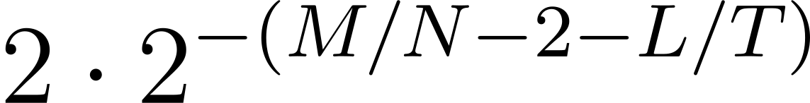
Analysis
Suppose keys in the dataset independently come from a “well-behaved” distribution
Avg. key length
FPR

Slide 314
Analysis
Suppose keys in the dataset independently come from a “well-behaved” distribution
Avg. key length
FPR
Bits per key budget

Slide 315
Analysis
Suppose keys in the dataset independently come from a “well-behaved” distribution
Avg. key length
FPR
Infix Store metadata overhead

Slide 316
Analysis
Suppose keys in the dataset independently come from a “well-behaved” distribution
Avg. key length
FPR
Per-key trie overhead

Slide 317
Analysis
Suppose keys in the dataset independently come from a “well-behaved” distribution
Avg. key length
FPR
Remainder size

Slide 318
Analysis
Suppose keys in the dataset independently come from a “well-behaved” distribution
Avg. key length
FPR
Collision probability

Slide 319
Analysis
Suppose keys in the dataset independently come from a “well-behaved” distribution
Avg. key length
FPR
Collision of two endpoints

Slide 320
Analysis
Suppose keys in the dataset independently come from a “well-behaved” distribution
Avg. key length
Independent of range size!
FPR

Slide 321
Analysis
Suppose keys in the dataset independently come from a “well-behaved” distribution
Avg. key length
FPR

Slide 322
Analysis
Suppose keys in the dataset independently come from a “well-behaved” distribution
Avg. key length
FPR
Time complexity

Slide 323

Analysis
Suppose keys in the dataset independently come from a “well-behaved” distribution
Avg. key length
FPR
Use a -Fast Trie

Slide 324
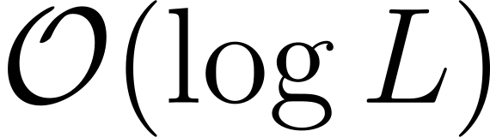
Analysis
Suppose keys in the dataset independently come from a “well-behaved” distribution
Avg. key length
FPR
Use a -Fast Trie
access and update time

Slide 325
Analysis
Suppose keys in the dataset independently come from a “well-behaved” distribution
Avg. key length
FPR

Slide 326
Analysis
Suppose keys in the dataset independently come from a “well-behaved” distribution
Avg. key length
FPR

Slide 327
Analysis
Suppose keys in the dataset independently come from a “well-behaved” distribution
Avg. key length
FPR
Insert/Delete/Query

Slide 328
Enjoy these types of problems?

Slide 329


Enjoy these types of problems?
Reach out to us and get involved in research!

